Slide 1



COMPUTER NETWORKS
Dr. U. SRILAKSHMI
Asst. Professor
Dept. of CSE
VFSTR

Slide 2
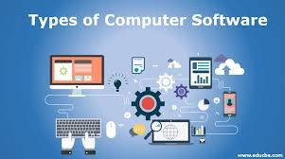
Network software
Protocol Hierarchies
Design Issues for the Layers
Connection-Oriented and Connectionless Services
Service Primitives
The Relationship of Services to Protocols

Slide 3
Protocol Hierarchies
To reduce the design complexity, most networks are organized as a series of layers or levels. Each one built upon the one below it.
The number of layers, name of each layer, contents of each layer and the function of each layer differ from network to network.
Layer n on one machine carries on a conversation with layer n on another machine. The rules and conventions used in this conversation are collectively known as the layer n protocol..
Between each pair of adjacent layers there is an interface..
A set of layers and protocols is called a network architecture..
A list of protocols used by a certain system , one protocol per layer, is called a protocol stack.

Slide 4
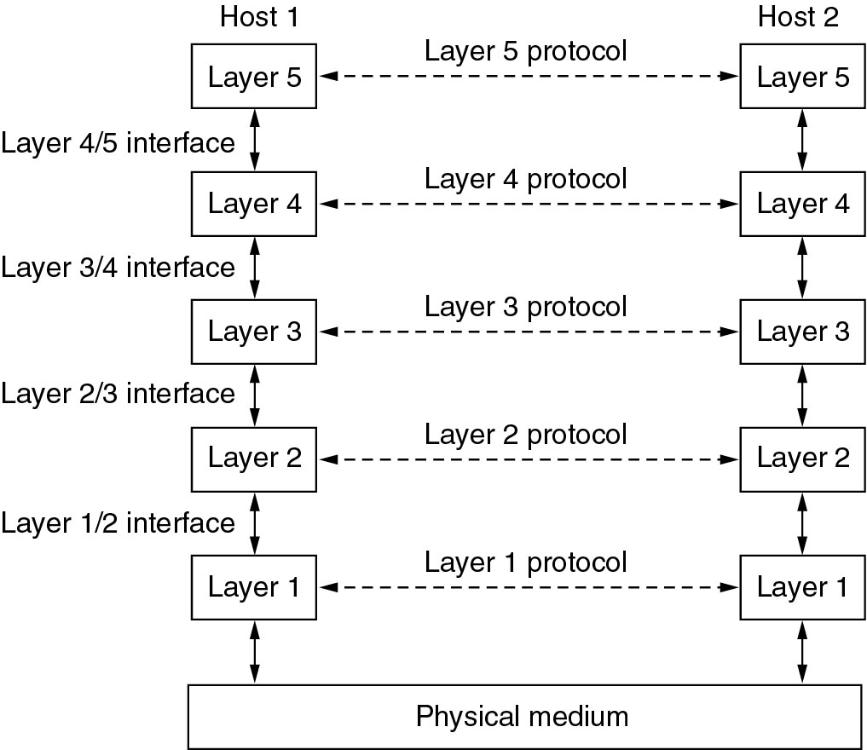
Protocol Hierarchies
Layers, protocols, and interfaces.

Slide 5
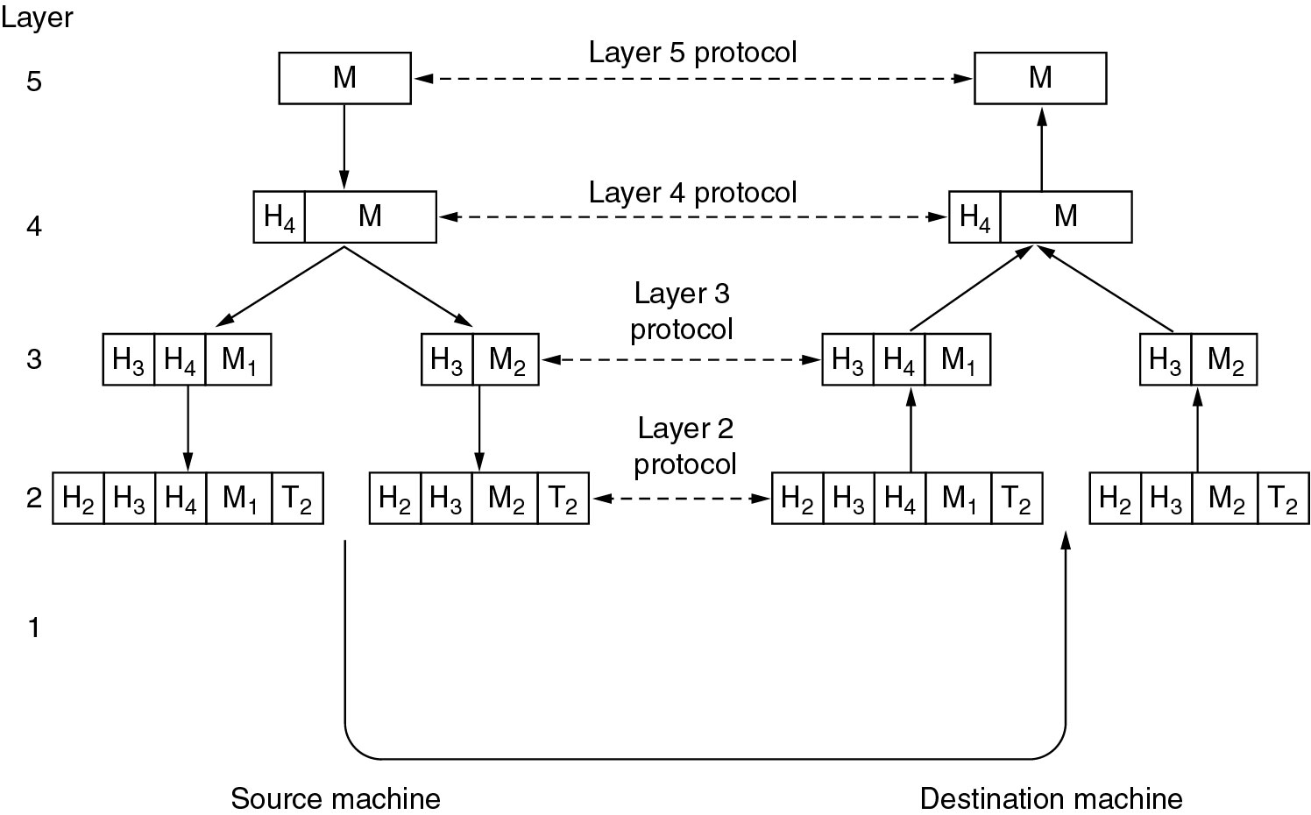
Protocol Hierarchies
Example information flow supporting virtual communication in layer 5.

Slide 6
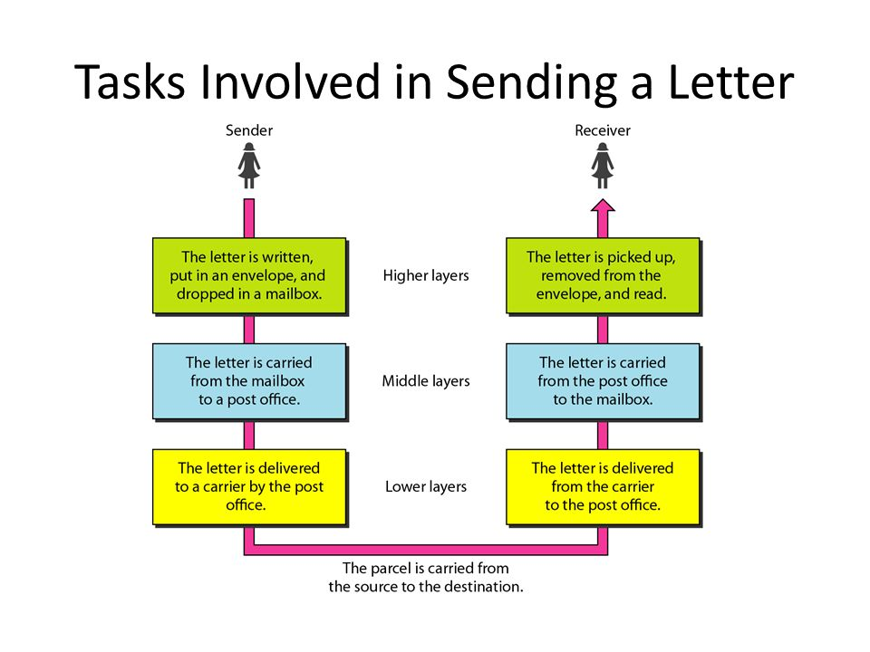
We use the concept of layers in our daily life.
As an example, let us consider two friends who communicate through postal mail.

Slide 7
Design Issues for the Layers
Addressing – each layer needs a mechanism for identifying senders and receivers.
The rules of data transfer – simplex, half-duplex, full- duplex.
Error Control – error-correction and error-detection.
Flow Control - The communication channels must preserve the order of messages sent on them – disassembling, transmitting, and then reassembling.
Multiplexing – inconvenient or expensive to set up a connection for each pair of communication process.
Routing – multiple paths between source and destination , a route must be chosen.

Slide 8
Connection-Oriented and Connectionless Services
Connection-oriented is modeled after the telephone system.
To talk to someone, you pick up the phone, dial the number, talk, and then hang up.
To use a connection-oriented network service, the service user first establish a connection, uses the connection, and then releases the connection.
Connectionless service is modeled after postal system.
Each message carries the full destination address, and each one routed through the system independent of all the routers.
When two messages sent to the same destination, the first one sent will be first one to arrive. If first one is delayed the second one arrives first.
With connection-oriented service this is not possible.

Slide 9
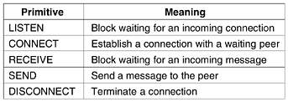
Service Primitives
Five service primitives for implementing a simple connection-oriented service.

Slide 10
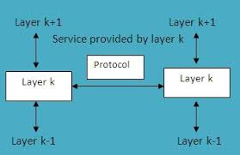
Services to Protocols Relationships
The relationship between a service and a protocol.
A service is a set of primitives (operations) that a layer provides to the layer above it.
A protocol is a set of rules governing the format and meaning of the frames, packets, or messages that are exchanged by the peer entities within the layer.

Slide 11

Reference Models
The OSI Reference Models
The TCP/IP Reference Models

Slide 12


OSI Reference Model
In 1947, the international standards organization(ISO) is a multinational body dedicated to worldwide agreement on international standards.
An ISO standard that covers all aspects of network communications is the open systems interconnection model.
In late 1970s an open system is a set of protocols that allow any two different systems to communicate
It divides the communications processes into seven layers.

Slide 13

The main concept of OSI is that the process of communication between two endpoints in a telecommunication network can be divided into seven distinct groups of related functions, or layers.
Each communicating user or program is at a computer that can provide those seven layers of function.
The seven layers of function are provided by a combination of applications, operating systems, network card device drivers and networking hardware that enable a system to put a signal on a network cable or out over Wi-Fi or other wireless protocol).

Slide 14
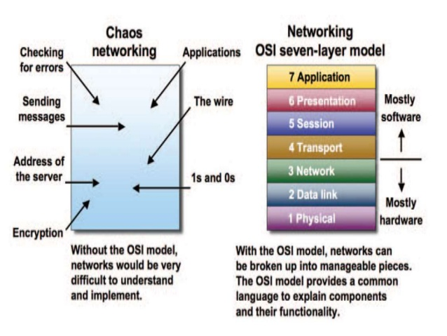
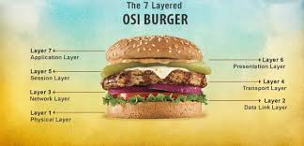

Slide 15
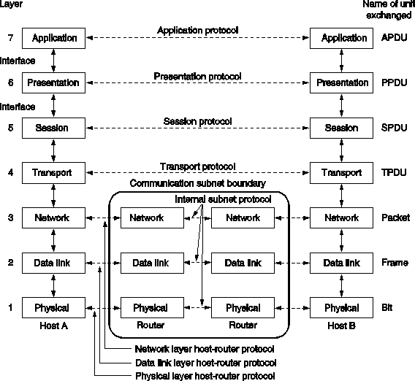
OSI Reference Model

Slide 16
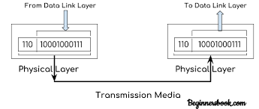
PHYSICAL LAYER
Converts bits into electronic signals for outgoing messages.
Converts electronic signals into bits for incoming messages.
The physical layer is concerned with transmitting raw bits over a communication channel. The design issues have to do with making sure that when one side sends a 1 bit, it is received by the other side as a 1 bit, not as a 0 bit.
The design issues are
• Transmission medium
• Synchronization of bits
• Physical topology
• Transmission mode
The bottom layer of the OSI model.

Slide 17
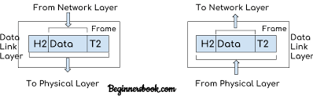
DATA LINK LAYER
The main task of the data link layer is to transform a raw transmission facility into a line that appears free of undetected transmission errors to the network layer.
It accomplishes this task by having the sender break up the input data into data frames (typically a few hundred or a few thousand bytes) and transmits the frames sequentially.

Slide 18
At the receiving end, this layer packages raw data from the physical layer into data frames for delivery to the Network layer.
At the sending end this layer handles conversion of data into raw formats that can be handled by the Physical Layer.
If the service is reliable, the receiver confirms correct receipt of each frame by sending back an acknowledgement frame.
The physical layer accepts and transmits stream of bits, the data link layer should create and recognize frame boundaries. This can be accomplished by attaching special bit patterns to the beginning and ending of frame.
A duplicate frame could be sent if the acknowledgement frame from receiver back to the sender were lost.

Slide 19
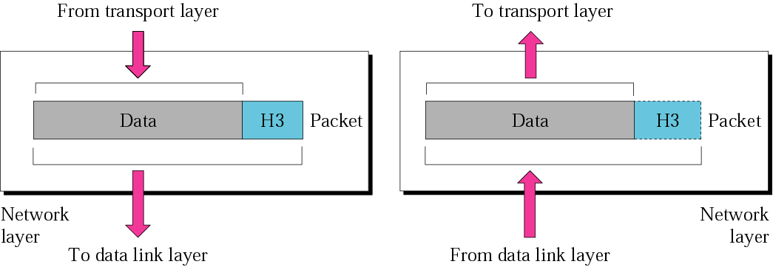
NETWORK LAYER
The network layer controls the operation of the subnet.
The network layer is responsible for the delivery of individual packets from the source host to the destination host.
The network layer controls the operation of the subnet.
A key design issue is determining how packets are routed from source to destination.

Slide 20
Routes can be based on static tables that are ''wired into'' the network and rarely changed.
They can also be determined at the start of each conversation.
If too many packets are present in the subnet at the same time, they will get in one another's way, forming bottlenecks.
The control of such congestion also belongs to the network layer.
When a packet has to travel from one network to another to get to its destination, many problems can arise.
The addressing used by the second network may be different from the first one.
The second one may not accept the packet at all because it is too large.
The protocols may differ, and so on. It is up to the network layer to overcome all these problems

Slide 21
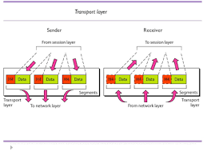
TRANSPORT LAYER

Slide 22
Manages the transmission of data across a network
Manages the flow of data between parties by segmenting long data streams into smaller data chunks (based on allowed “packet” size for a given transmission medium)
Reassembles chunks into their original sequence at the receiving end
Provides acknowledgements of successful transmissions and requests resends for packets which arrive with errors
The basic function of the transport layer is to accept data from above, split it up into smaller units if need be, pass these to the network layer, and ensure that the pieces all arrive correctly at the other end.
The transport layer is responsible for the delivery of a message from one process to another.

Slide 23
If transport connection requires a high throughput, the transport layer might create multiple network connections.(if expensive multiple several transport connections onto the same network connection).
The transport layer also determines what type of service to provide to the session layer, and, ultimately, to the users of the network. The most popular type of transport connection is an error-free point-to-point channel that delivers messages or bytes in the order in which they were sent. The type of service is determined when the connection is established.
The transport layer is a true end-to-end layer, all the way from the source to the destination.
The difference between layer 1 through 3 , which are chained, and layer 4 through 7, which are end-to-end

Slide 24
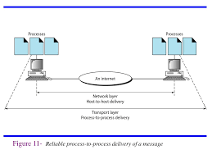
TRANSPORT LAYER
Reliable Process - to - Process delivery of a message.

Slide 25
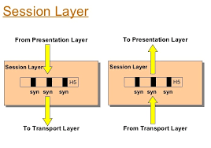
SESSION LAYER
The session layer allows users on different machines to establish sessions between them.
Sessions offer various services, including dialog control (keeping track of whose turn it is to transmit), token management (preventing two parties from attempting the same critical operation at the same time), and synchronization (check pointing long transmissions to allow them to continue from where they were after a crash).

Slide 26
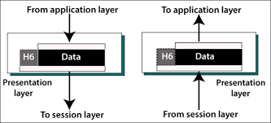
PRESENTATION LAYER
The presentation layer is concerned with the syntax and semantics of the information transmitted.
In order to make it possible for computers with different data representations to communicate, the data structures to be exchanged can be defined in an abstract way, along with a standard encoding to be used ''on the wire.''
The presentation layer manages these abstract data structures and allows higher-level data structures (e.g., banking records), to be defined and exchanged.

Slide 27
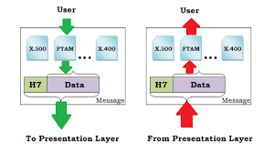
APPLICATION LAYER
The application layer is responsible for providing services to the user.
The application layer contains a variety of protocols that are commonly needed by users. One widely-used application protocol is HTTP (Hypertext Transfer Protocol), which is the basis for the World Wide Web.
When a browser wants a Web page, it sends the name of the page it wants to the server using HTTP.
The server then sends the page back.
Other application protocols are used for file transfer, electronic mail, and network news.
Network virtual terminal

Slide 28
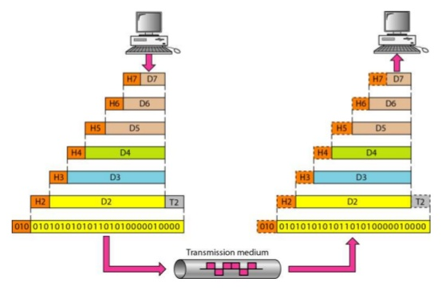
An Exchange using the OSI model.

Slide 29
THE SEVEN OSI REFERENCE MODEL LAYER
Application Layer
Network Process to Applications
Presentation Layer
Data Representation
Session Layer
Inter Host Communication
Transport Layer
End - to - end Connections
Network Layer
Address and Best Path
Data Link Layer
Access to Media
Physical Layer
Binary Transmission

Slide 30
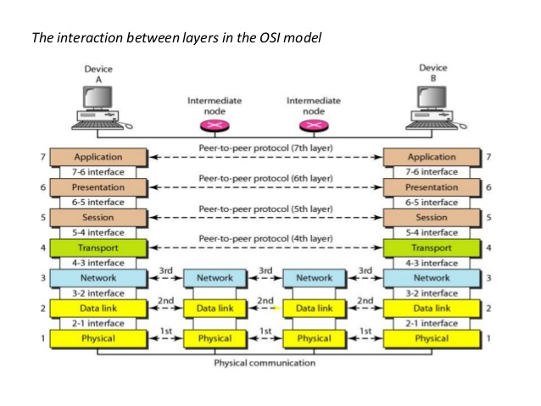
The Interaction between Layers in the OSI model

Slide 31
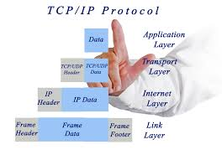
The TCP/IP reference model
The TCP/IP reference model was developed prior to OSI model.
The major design goals of this model were,
1. To connect multiple networks together so that they appear as a single network.
2. To survive after partial subnet hardware failures.
3. To provide a flexible architecture.
Transmission control protocol/ information protocol
Unlike OSI reference model, TCP/IP reference model has only 4 layers. They are,
1. Host-to-Network Layer
2. Internet Layer
3. Transport Layer
4. Application Layer

Slide 32
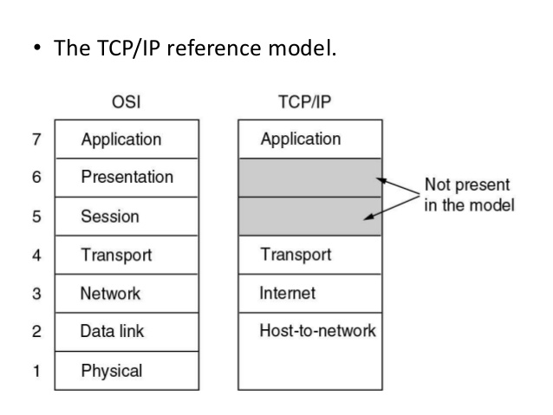


The TCP/IP Reference Model

Slide 33
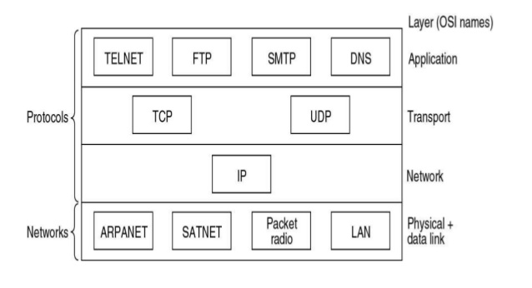
The TCP/IP reference model
Protocols and networks in the TCP/IP model initially.

Slide 34
Internet Layer
Its job is to permit hosts to inject packets into any network and have they travel independently to the destination (potentially on a different network).
They may even arrive in a different order than they were sent, in which case it is the job of higher layers to rearrange them, if in-order delivery is desired.
The internet layer defines an official packet format and protocol called IP (Internet Protocol).
The job of the internet layer is to deliver IP packets where they are supposed to go.
Packet routing is clearly the major issue here, as is avoiding congestion.

Slide 35
Transport Layer
It is designed to allow peer entities on the source and destination hosts to carry on a conversation, just as in the OSI transport layer.
Two end-to-end transport protocols have been defined here.
TCP (Transmission Control Protocol), is a reliable connection-oriented protocol that allows a byte stream originating on one machine to be delivered without error on any other machine in the internet.
– It fragments the incoming byte stream into discrete messages and passes each one on to the internet layer. At the destination, the receiving TCP process reassembles the received messages into the output stream.
TCP also handles flow control
UDP (User Datagram Protocol), is an unreliable, connectionless protocol for applications that do not want TCP's sequencing or flow control and wish to provide their own.
– It is also widely used for one-shot, client-server-type request-reply queries and applications in which prompt delivery is more important than accurate delivery(transmitting speech or video.)

Slide 36
Application Layer
The TCP/IP model does not have session or presentation layers.
On top of the transport layer is the application layer.
It contains all the higher-level protocols.
The early ones included virtual terminal (TELNET), file transfer (FTP), and electronic mail (SMTP).
The virtual terminal protocol allows a user on one machine to log onto a distant machine and work there.
The file transfer protocol provides a way to move data efficiently from one machine to another.
Electronic mail was originally just a kind of file transfer, but later a specialized protocol (SMTP) was developed for it.
Many other protocols have been added to these over the years: the Domain Name System (DNS) for mapping host names onto their network addresses, and HTTP, the protocol for fetching pages on the World Wide Web, and many others.

Slide 37
Telnet
Telnet is a network protocol used on the Internet or local area networks to provide a bidirectional interactive text-oriented communication facility using a virtual terminal connection.
The term telnet may also refer to the software that implements the client part of the protocol.
Telnet client applications are available for virtually all computer platforms.
To telnet means to establish a connection with the Telnet protocol, either with command line client or with a programmatic interface.
The Telnet program runs on your computer and connects your PC to a server on the network.
You can then enter commands through the Telnet program and they will be executed as if you were entering them directly on the server.
This enables you to control the server and communicate with other servers on the network.
To start a Telnet session, you must log in to a server by entering a valid username and password.
Telnet is a common way to remotely control Web servers.

Slide 38
File Transfer Protocol
The File Transfer Protocol (FTP) is a standard network protocol used to transfer computer files from one host to another host over a TCP-based network, such as the Internet.
FTP is built on a client-server architecture and uses separate control and data connections between the client and the server.
The first FTP client applications were command-line applications developed before operating systems had graphical user interfaces, and are still shipped with most Windows, Unix, and Linux operating systems.
Many FTP clients and automation utilities have since been developed for desktops, servers, mobile devices, and hardware, and FTP has been incorporated into productivity applications, such as Web page editors

Slide 39
Simple Mail Transfer Protocol
Simple Mail Transfer Protocol (SMTP) is an Internet standard for electronic mail (e-mail) transmission
Short for Simple Mail Transfer Protocol, a protocol for sending e-mail messages between servers.
Most e-mail systems that send mail over the Internet use SMTP to send messages from one server to another; the messages can then be retrieved with an e-mail client using either POP or IMAP.
In computing, the Post Office Protocol (POP) is an application-layer Internet standard protocol used by local e- mail clients to retrieve e-mail from a remote server over a TCP/IP connection.
Virtually all modern e-mail clients and servers support POP and IMAP (Internet Message Access Protocol) are the two most prevalent Internet standard protocols for e-mail retrieval ,with many webmail service providers such as Gmail, Outlook.com and Yahoo! Mail also providing support for either IMAP or POP3 to allow mail to be downloaded.

Slide 40
Domain Name System
The Domain Name System (DNS) is a hierarchical distributed naming system for computers, services, or any resource connected to the Internet or a private network.
It associates various information with domain names assigned to each of the participating entities.
The Domain Name System distributes the responsibility of assigning domain names and mapping those names to IP addresses by designating authoritative name servers for each domain.
Authoritative name servers are assigned to be responsible for their supported domains.
This mechanism provides distributed and fault tolerant service and was designed to avoid the need for a single central database.

Slide 41
Host - to - Network Layer
The TCP/IP reference model does not really say much about what happens here, except to point out that the host has to connect to the network using some protocol so it can send IP packets to it.
This protocol is not defined and varies from host to host and network to network.

Slide 42
Arpanet
The Advanced Research Projects Agency Network (ARPANET) was one of the world's first operational packet switching networks, the first network to implement TCP/IP, and was the main progenitor of what was to become the global Internet.
The network was initially funded by the Advanced Research Projects Agency (ARPA, later DARPA) within the U.S. Department of Defense for use by its projects at universities and research laboratories in the US.
The packet switching of the ARPANET, together with TCP/IP, would form the backbone of how the Internet works.

Slide 43
SATNet
SATNet - Satellites Network
The SATNet network is providing the first network for sharing ground stations in between the members of the community of CubeSat developers.
Packet Ratio
Packet radio is a form of packet switching technology used to transmit digital data via radio or wireless communications links.
It uses the same concepts of data transmission via Datagram.
Data Gram
A datagram is a basic transfer unit associated with a packet-switched network. The delivery, arrival time, and order of arrival need not be guaranteed by the network.

Slide 44
Comparing OSI and TCP/IP Models
Concepts central to the OSI model
Services
Interfaces
Protocols

Slide 45
A Critique of the OSI Model and protocols
Bad timing
Bad technology
Bad implementations
Bad politics

Slide 46
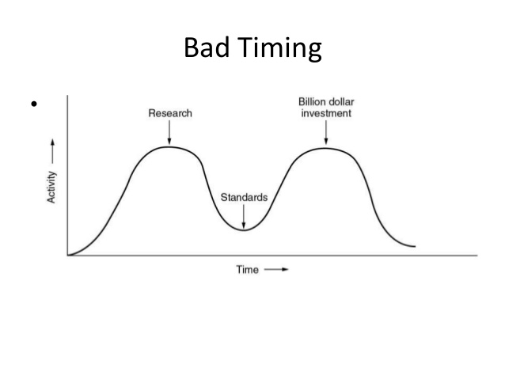
Bad Timing

Slide 47
A Critique of the TCP/IP Reference Model
Problems:
Service, interface, and protocol not distinguished
Not a general model
Host-to-network “layer” not really a layer
No mention of physical and data link layers
Minor protocols deeply entrenched, hard to replace

Slide 48
A Critique of the TCP/IP Reference Model
Problems:
Service, interface, and protocol not distinguished
Not a general model
Host-to-network “layer” not really a layer
No mention of physical and data link layers
Minor protocols deeply entrenched, hard to replace

Slide 49
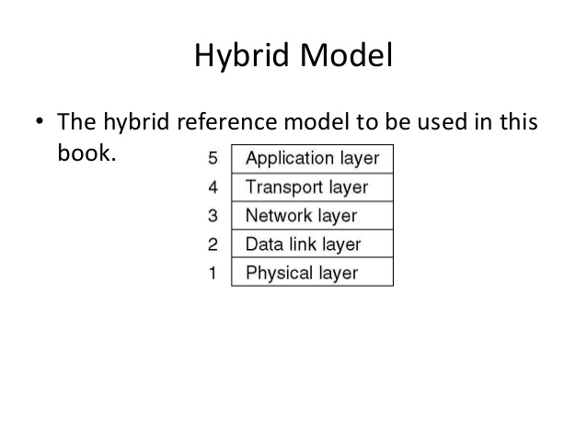
Hybrid Model
The hybrid reference model to be used.

Slide 50
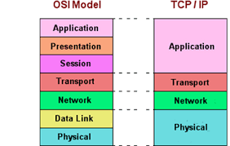
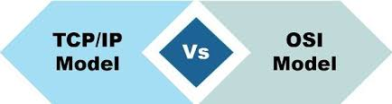
Differences Between OSI and TCP/IP Model

Slide 51
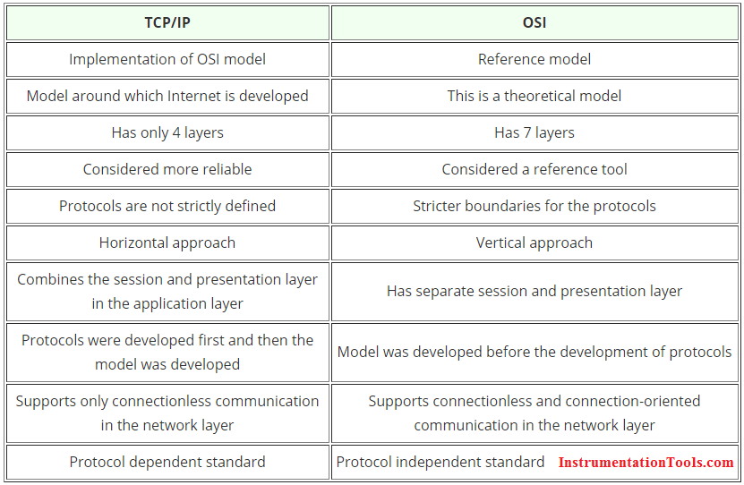
Differences Between OSI and TCP/IP Model

Slide 52
THANKS!
Any questions?

